Slide 1
PV Student Community
Ashley Brown, Olivia Benjamin, Jalisa Perkins

Slide 2
What’s New?
Insert EXTRA
Storyboard updated
Insert EXTRA
Personality Quiz Page
Landlord Page

Slide 3
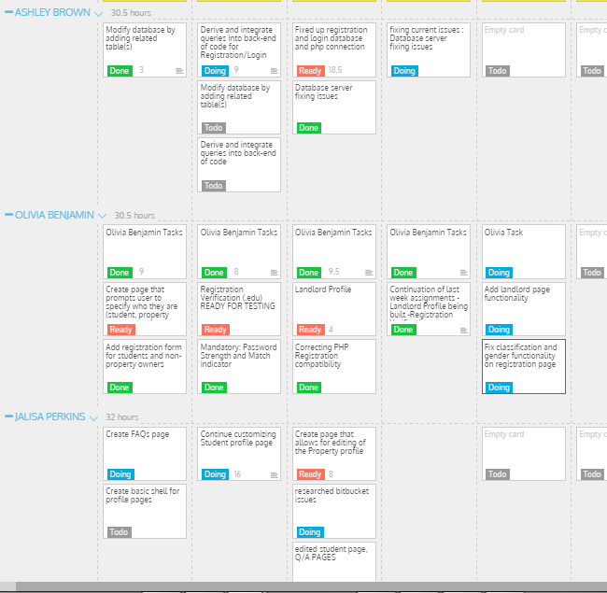
User Storyboard
https://pvcommunity.storiesonboard.com/#/m/mapshop-sample
Storyboard has been updated

Slide 4
insert
Insert information

Slide 5
insert
Insert information

Slide 6
Psychology Personality Matching
Algorithm Selection
Adding Results ( research completed )
Personality Page

Slide 7
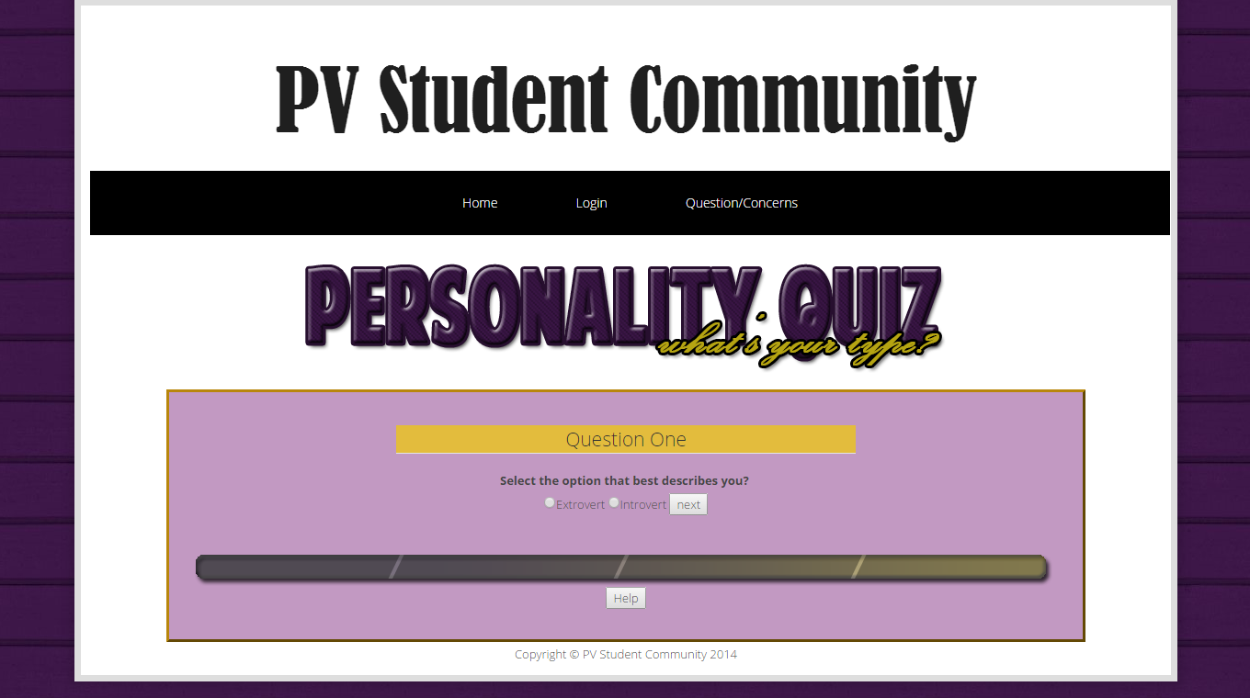
Personality Page Created
Insert information

Slide 8
Landlord Page Functionality
Uploading and editing images
Users being able to edit their information
Previewing profile

Slide 9
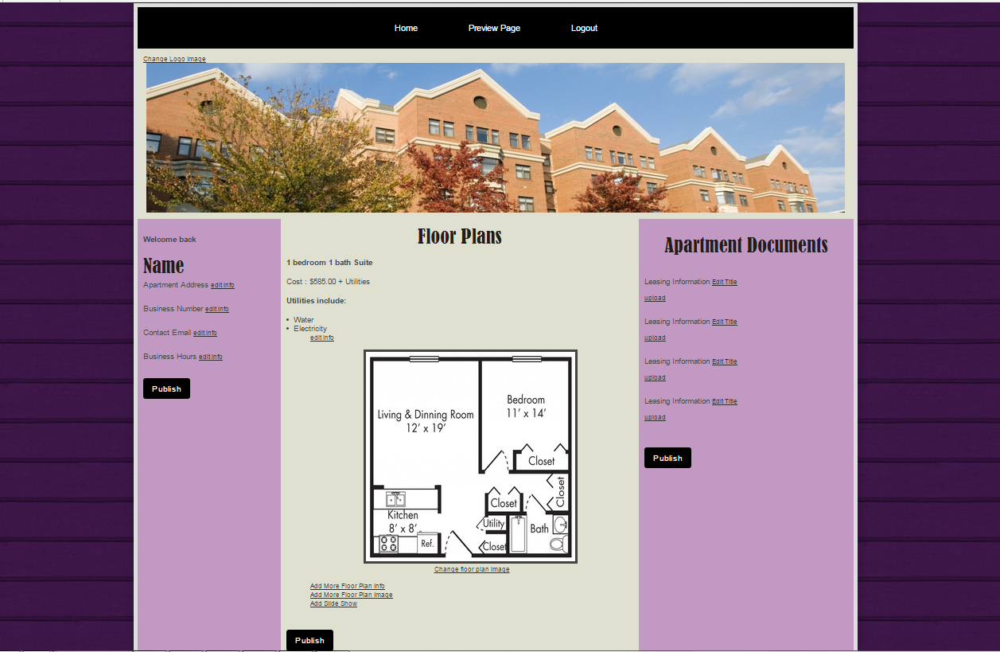
Landlord Page Shell Completed

Slide 10
insert
Insert information

